Slide 1
Driving Toward the Next Normal: Swimming with Black Swans
Dr. Allan Gray, Executive Director
Center for Food and Agricultural Business

Slide 2
Strategic thinking in times of crisis
COVID 19 completely changed the current global landscape and also changed the way we imagine the future;
Strategic planning is more about being prepared for the possibilities of the future than trying to guess a particular future.
Surviving is imperative, but what about the “day after”? What might the “new normal” be? What will drive these changes?
How can we begin to prepare for this new normal?
Tomorrow is not yesterday

Slide 3
Drivers of Change

Slide 4
Key Drivers of a Post Pandemic World
Deglobalization
Resilience versus Efficiency
Contact-free Economy
More Government Intervention
More Business Scrutiny
Industry Structure shifts
Employment shifts
Silver linings

Slide 5
Drivers of change
Deglobalization:
Going against the tendency observed in the 1990s and 2000s, protectionism and restrictive attitudes began to appear, even before the pandemic hit, now they are stronger than ever;
More than three billion people live in countries whose borders are now totally closed to nonresidents;
Data from the World Bank, Market Access Maps, and Global Trade Alert as of late-April indicate 17 countries have implemented a total of 40 policy constraints on agricultural exports;
Local > Global;
Supply chains driving a move to bring sourcing closer to end markets.

Slide 6
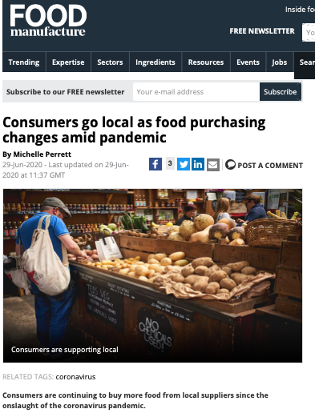
Drivers of change
Deglobalization:
local Food Systems:
3 interesting characteristics:
Geographic Proximity;
Fewer Steps between the Farm and the Table;
Smaller Production Capacity.
There is an argument for keeping the income circulating locally
The shift from global food systems to local alludes to a potential built-in resilience;
Scale and supply chain capacity designed to capture efficiencies, any shift would have cost implications to the food system;

Slide 7
Drivers of change
Resilience versus efficiency:
The ability to absorb a shock, and to come out of it better than the competition will be the key to survival and long-term prosperity;
Resilient companies usually bounce back much faster after the crisis;
The key to resilience is preparation before the crisis, specifically, the ability to cut operating costs;
But just adjusting the business might not be enough, you may need to rethink it (ex: restructuring of supply chains);
Companies will rebalance their priorities, so that resiliency, in all its manifestations, becomes just as important to their strategic thinking as cost and efficiency.

Slide 8
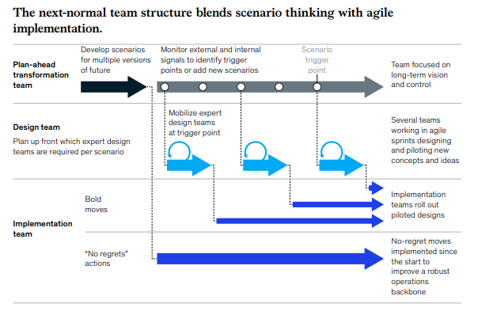
Drivers of change

Slide 9
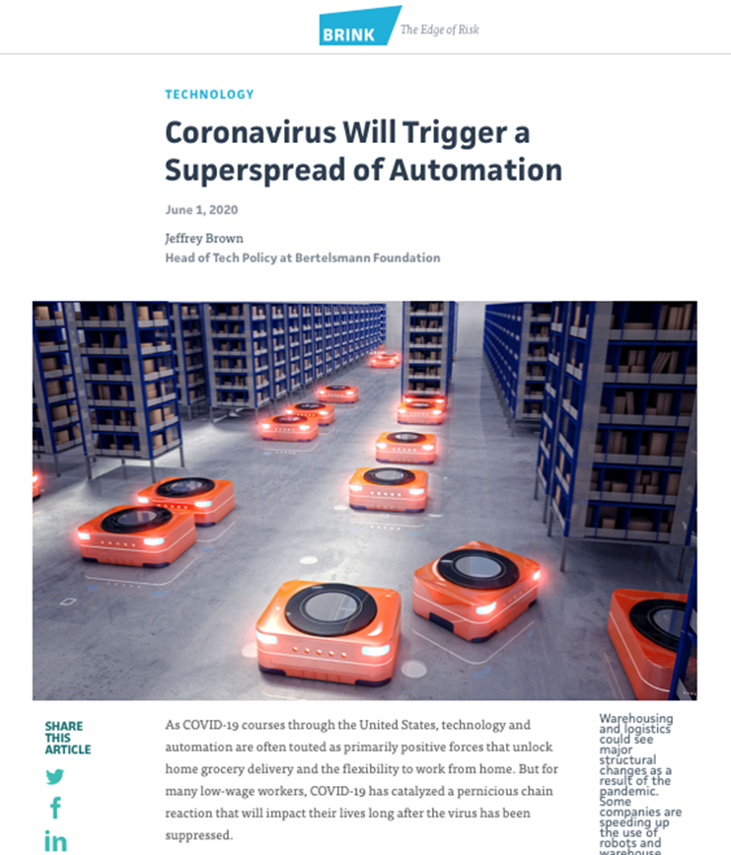
Drivers of change
Contact-free economy:
Digital Commerce
trending up even before the pandemic;
In Italy alone, e-commerce transactions have risen 81 percent since the end of February.
Telemedicine
Teladoc Health, the largest US stand-alone telemedicine service, reported a 50 percent increase in service in the week ending March 20;
Automation
McKinsey Global Institute estimated 60 percent of all jobs could see 30 percent of their key tasks automated, affecting 400 million to 800 million jobs around the world by 2030

Slide 10
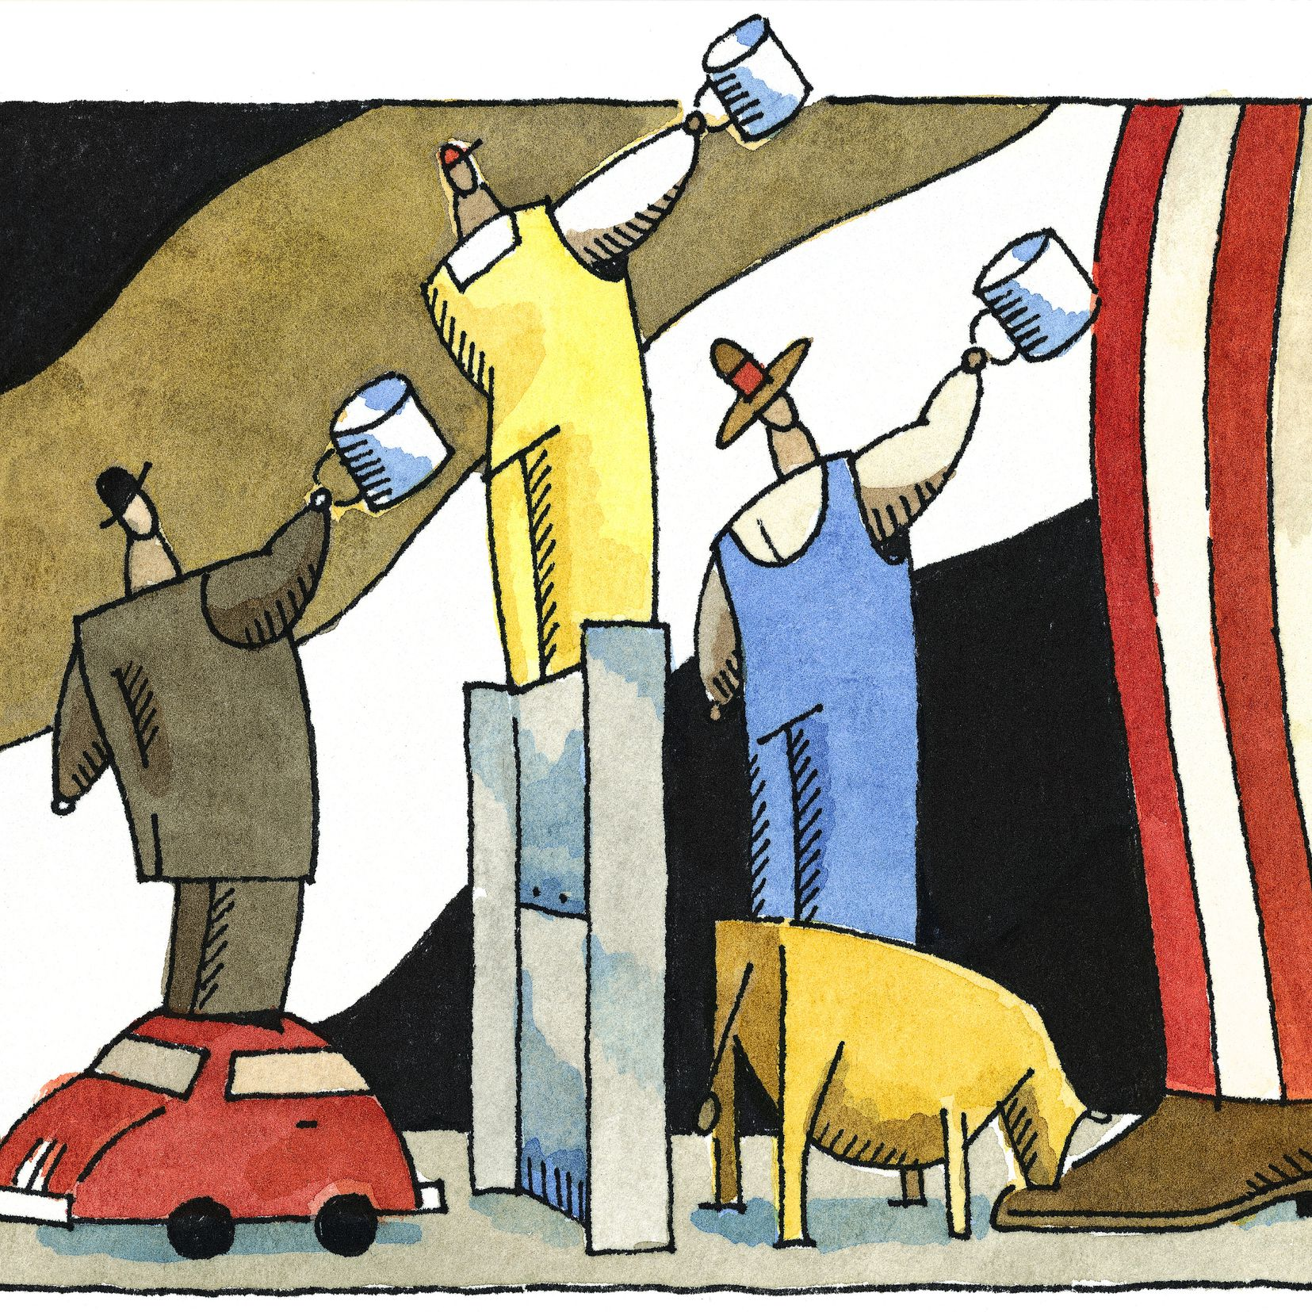
Drivers of change
More government intervention in the economy:
During times of great crisis citizens have proved willing to accept greater government control of the economy;
As of April 10, governments across the globe had announced stimulus plans amounting to $10.6 trillion, the equivalent of eight Marshall Plans.
As interventions are more common, the implications for the role of the state will materially affect the way business is conducted;

Slide 11
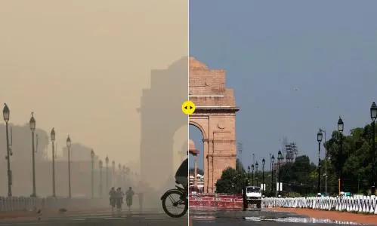
Drivers of change
The triple bottom-line:
Even before the coronavirus, there was a growing sense that shareholder value should not be the only corporate value;
With many businesses likely to be operating to some extent with public money, the scrutiny will intensify;
More expectations: social features, environmental stewardship, labor relations and financial responsibility and accountability;

Slide 12
Drivers of change
Industry Structure Shifts:
Shutdown and stay-at-home orders resulted in a significant reduction in demand for food eaten away from home settings;
In mid to late March 2020, sales in grocery outlets increased 90% relative to the year prior;
Increased health awareness and a corresponding desire to live more healthily could bring lasting change to where, how, and what people eat;

Slide 13
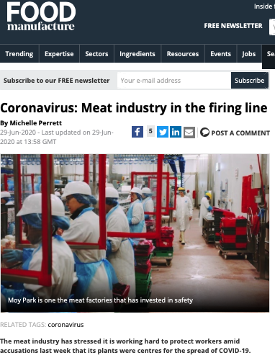
Drivers of change
Industry Structure Shifts
The US meat industry example:
The ability to harvest animals was constrained while the farm level produced record large volumes; the industry had a “surplus” of livestock and yet a “shortage” of meat for consumers;
Livestock prices plummeted, while retail and food service channels experienced reduced meat availability and a mix of higher prices, altered product offerings, and rationing of purchases;
Highlighted vulnerability where labor is most involved; desipite mass layoffs in several industries, the meat processing sector faced critical workforce shortages;
Expected Results: chain structural changes, increased automation, additional storage capacity, etc.

Slide 14
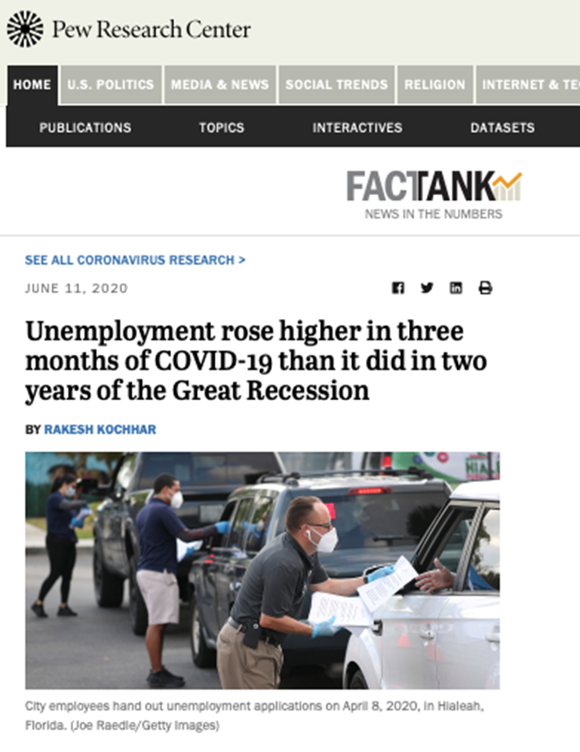
Drivers of change
7. Structural Employment Shifts:
COVID-19 has forced businesses to close and unemployment to rise exponentially. It remains to be seen if the pandemic leads a permanent change;
The risks it poses has led to a large increase in the generosity of the welfare state;
High offer of workers may lower the overall wages average;
Unemployment seems to be especially problematic for lower educated workers.

Slide 15
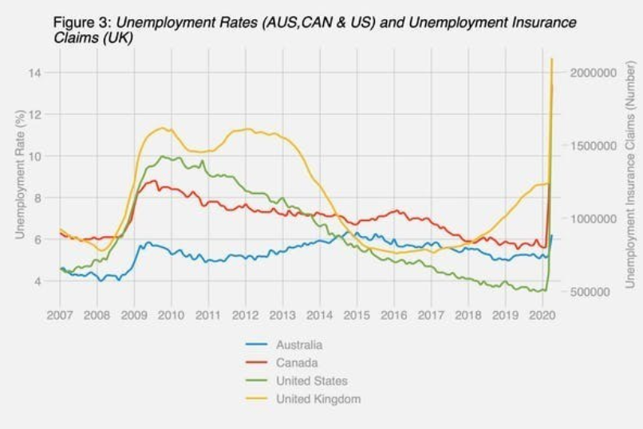
Drivers of change
7. Structural Employment Shifts:

Slide 16
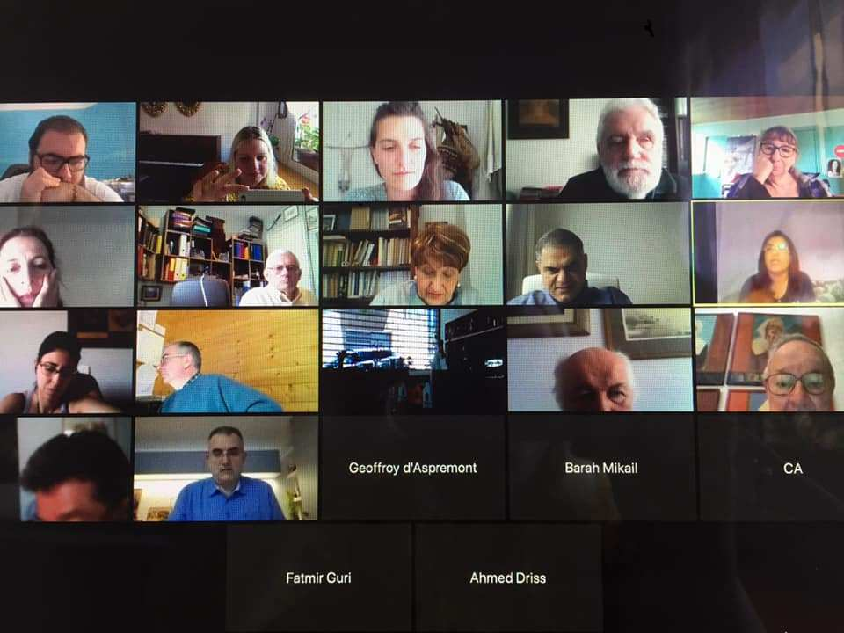
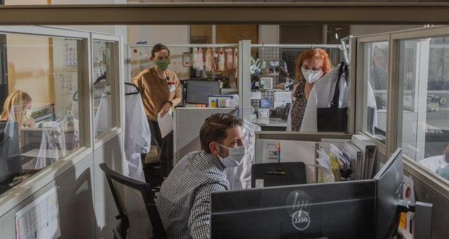
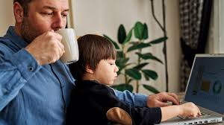
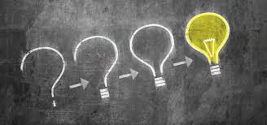
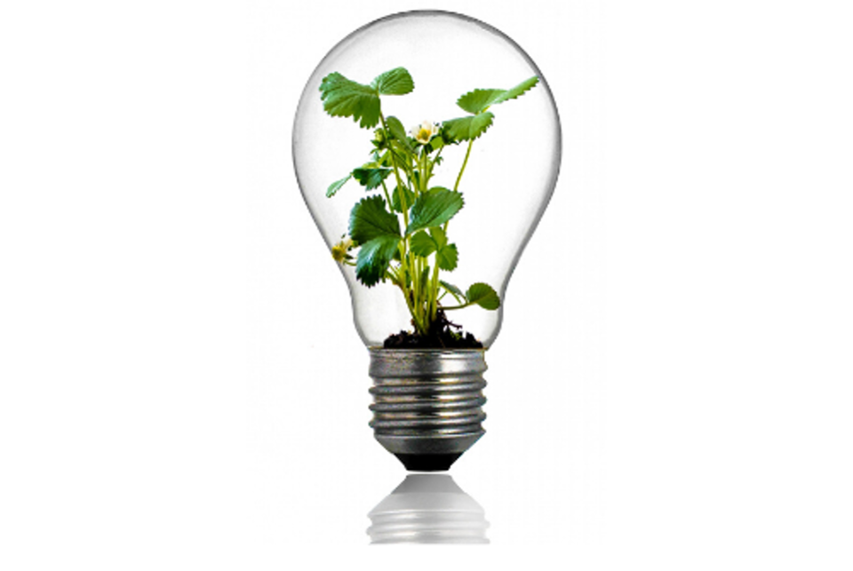
Drivers of change
8. Finding the silver linings:
Individuals, communities, businesses, and governments alike are all learning new ways to connect: almost everyone knows a story of the grandparent who finally learned to Zoom, Skype, or FaceTime.
Better management and more flexible workforces.
The coronavirus is forcing both the pace and scale of innovation.

Slide 17
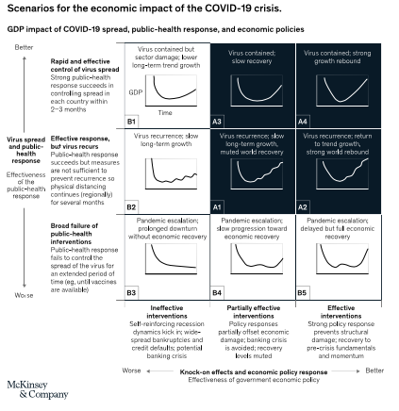
Scenarios for the post COVID-19
WTO forecasts 3 scenarios for recovery:
V-Shaped GDP variation:
2020: -4.8%
2021: +4.2%
U-Shaped GDP Variation:
2020: -9.2%
2021: +8.1%
L-Shaped GDP Variation:
2020: -11.1%
2021: +2.8%
Source: Safeguarding our lives and our livelihoods: The imperative of our time. McKinsey & Company, March 2020 by Sven Smit, Martin Hirt, Kevin Buehler, Susan Lund, Ezra Greenberg, and Arvind Govindarajan
Source: Global Trade in Agricultural Products: The Likely Impact of COVID-19. By Ian Sheldon and Jason Grant

Slide 18
Implications for Agriculture Markets
The impacts of the massive demand shock associated with the COVID-19 pandemic on crop markets looks to continue over the next couple of years;
Implications for major field crops tend toward growing global ending stock levels, lower prices, and tighter margins;
A more optimistic price scenario requires a quick V-shaped global economic recovery, weather-related production shortfalls in major crop producing areas, or both;
The pandemic will have a strong negative impact on farm income;
Production costs are expected to decrease, and government payments are expected to increase from the baseline;
COVID-19 has had an impact on US interest rates, lowering them considerably. The financial position of lenders is such that credit will likely be available to financially viable producers.

Slide 19
Strategies for the Next Normal

Slide 20
Resilient, Responsive, and Resourceful
Start-up mindset
This favors action over research and testing over analysis;
Human at the core
Companies will need to rethink their operating model based on how their people work best.
Acceleration of digital, tech, and analytics
The best companies successfully using advanced analytics to combine new sources of data to make better and faster decisions and strengthen their links to customers;
Purpose-driven customer playbook
Understand what customers will value, post-COVID-19, and develop new use cases and tailored experiences based on those insights;
Ecosystems and adaptability
Changing the ecosystem and considering nontraditional collaborations with partners up and down the supply chain;

Slide 21
Rethinking the organization
Who we are
Strategy, roles, personal ownership, external orientation, and leadership that is both supportive and demanding;
How we work
A flatter organization that delegates decision making down to a dynamic network of teams is more effective;
Matching the right talent, regardless of hierarchy, to the most critical challenges.
How to grow
Three factors will matter most: the ability to embed data and analytics in decision making; the creation of learning platforms for experimentation; and the cultivation of an organizational culture that fosters value creation with other partners.

Slide 22
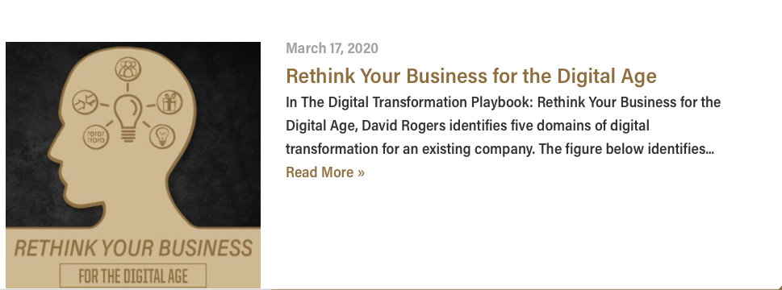
Center for Food and Agricultural Business Resources

Slide 23
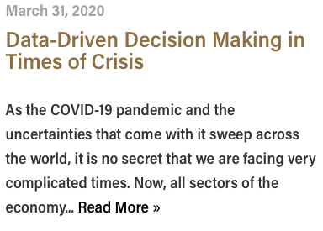
Center for Food and Agricultural Business Resources

