Slide 1
To Infinity …. and Beyond: Meat
Jayson L. Lusk
Distinguished Professor and Head
Department of Agricultural Economics
Purdue University
jayson.lusk@gmail.com
www.jaysonlusk.com
@JaysonLusk

Slide 2
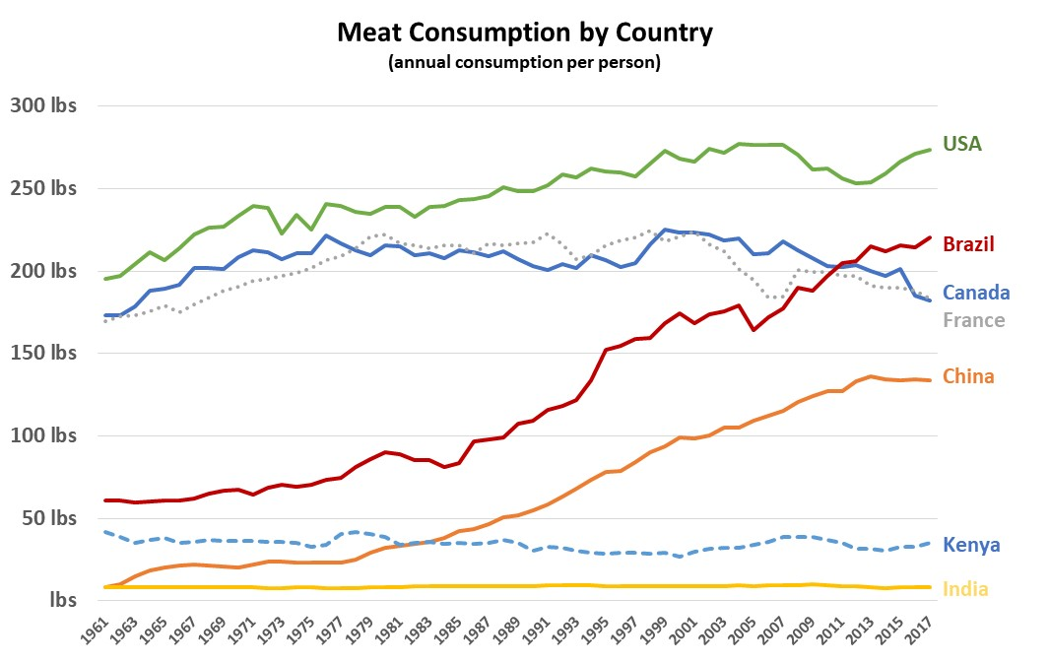
Source: UN FAO

Slide 3
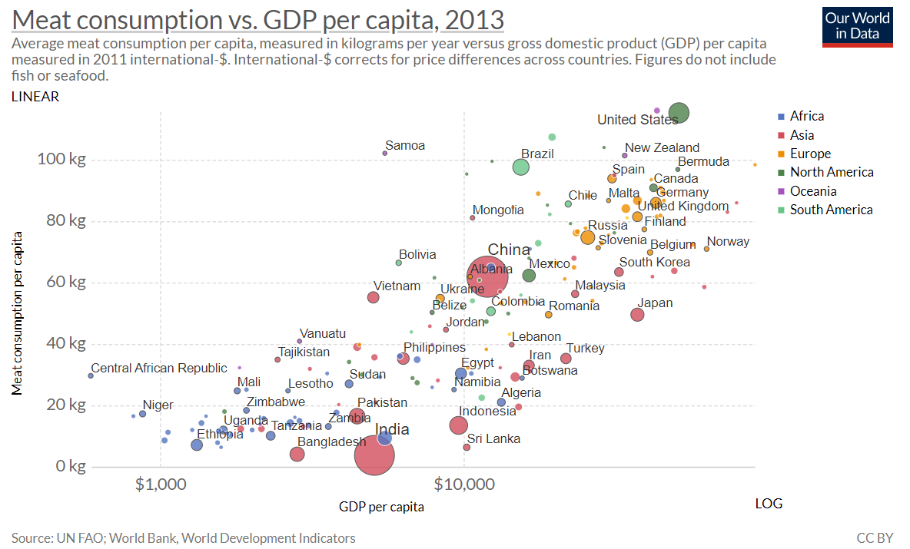

Slide 4
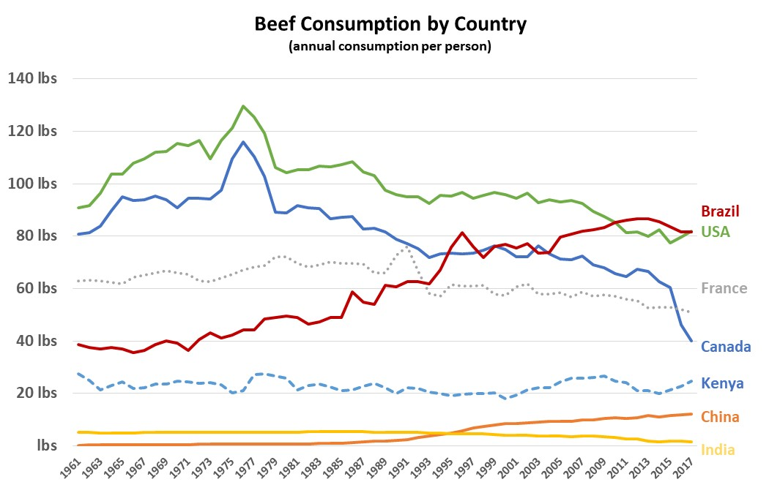
Source: UN FAO

Slide 5
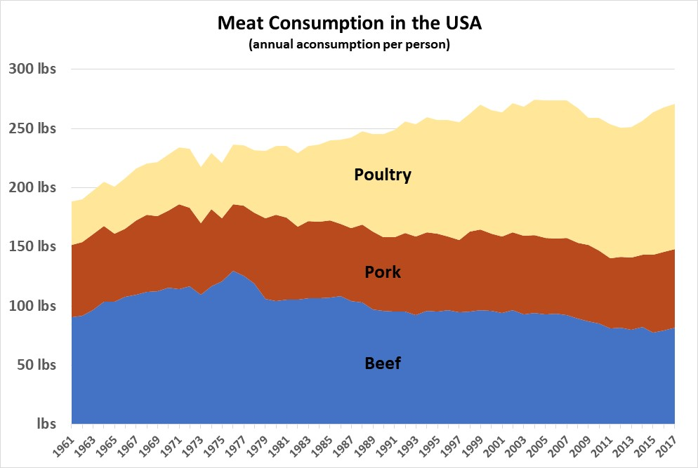
Source: UN FAO

Slide 6
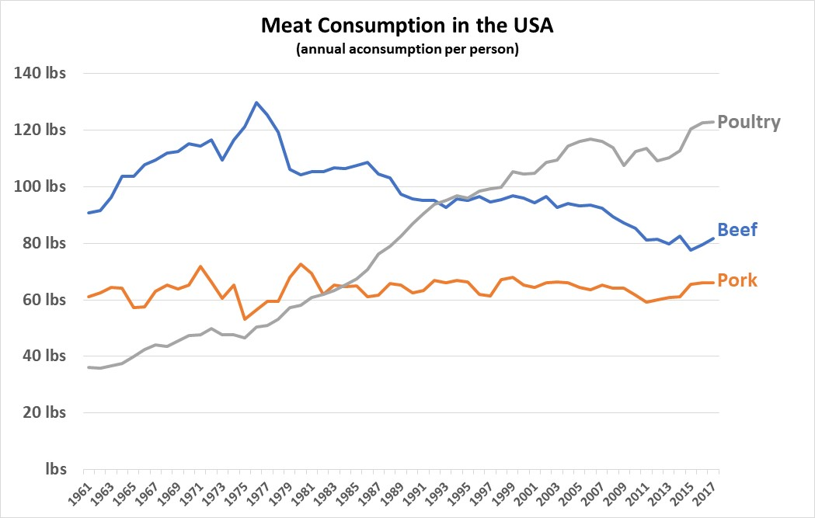
Source: UN FAO

Slide 7
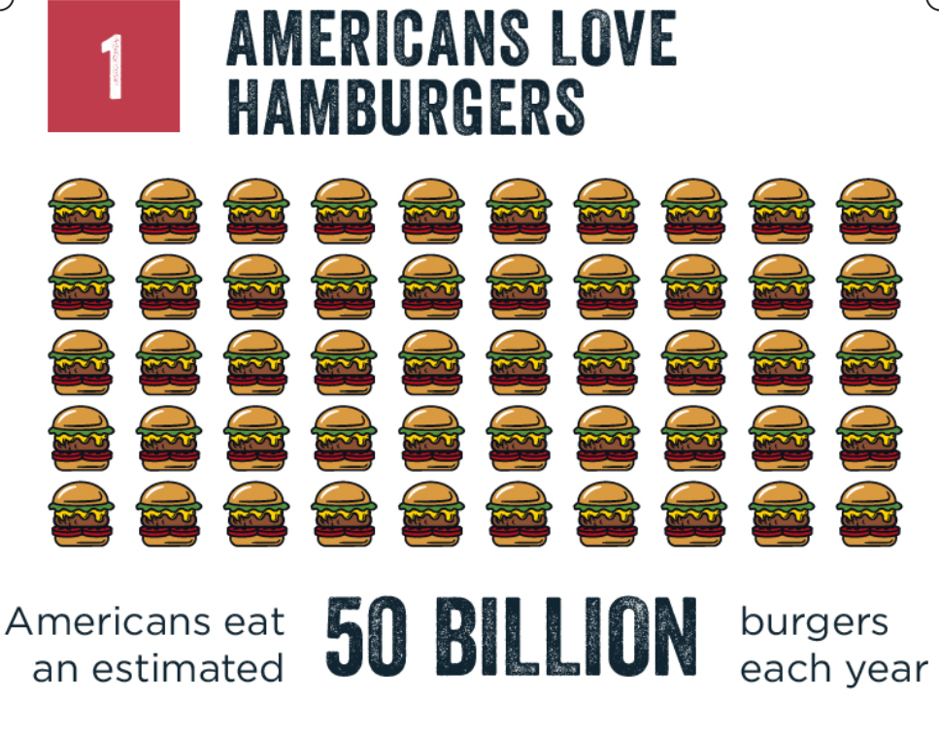
U.S. per capita consumption of retail beef as 57lbs/person/year in 2018

Slide 8
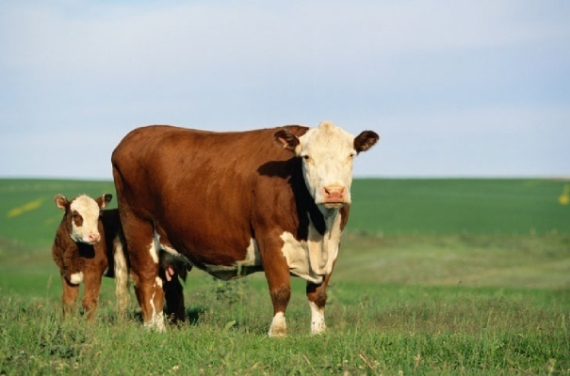
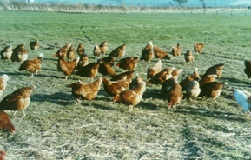
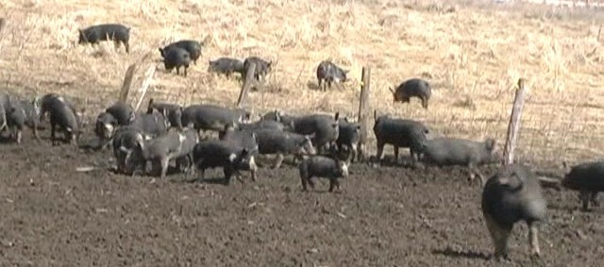
When you think about meat production, do you think about
this . . .

Slide 9
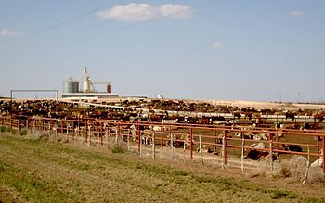
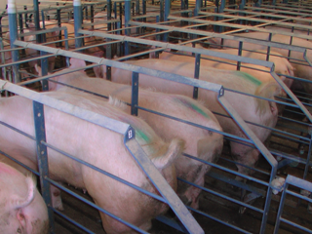
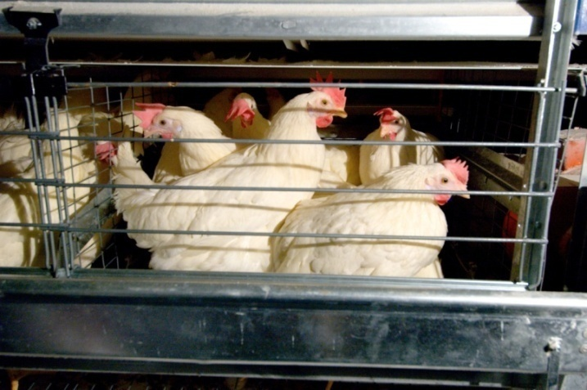
or this . . .

Slide 10
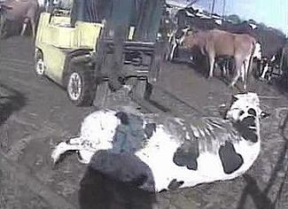

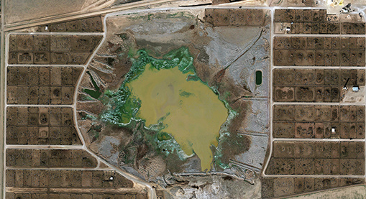
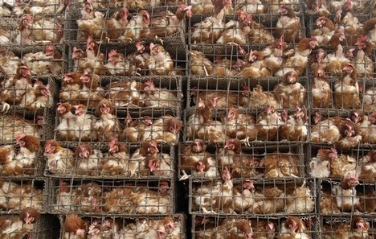
or this . . .

Slide 11
Mounting Criticisms
  Environment
  Health
  Animal Welfare
  Food Safety

Slide 12
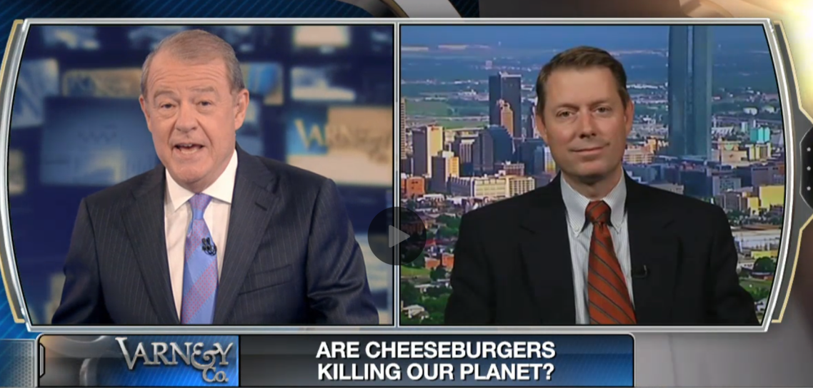
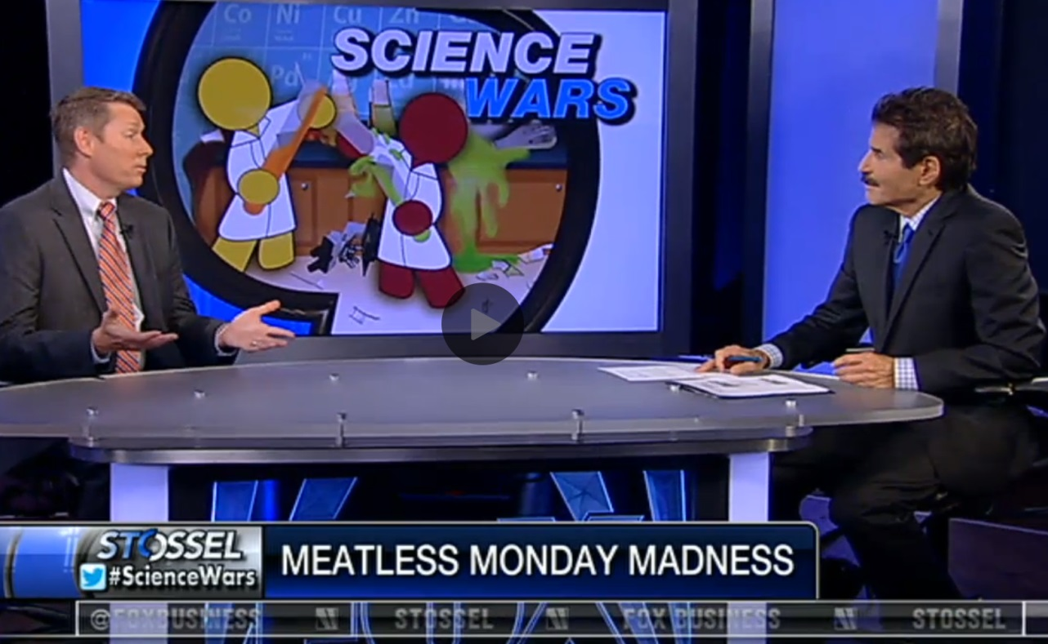
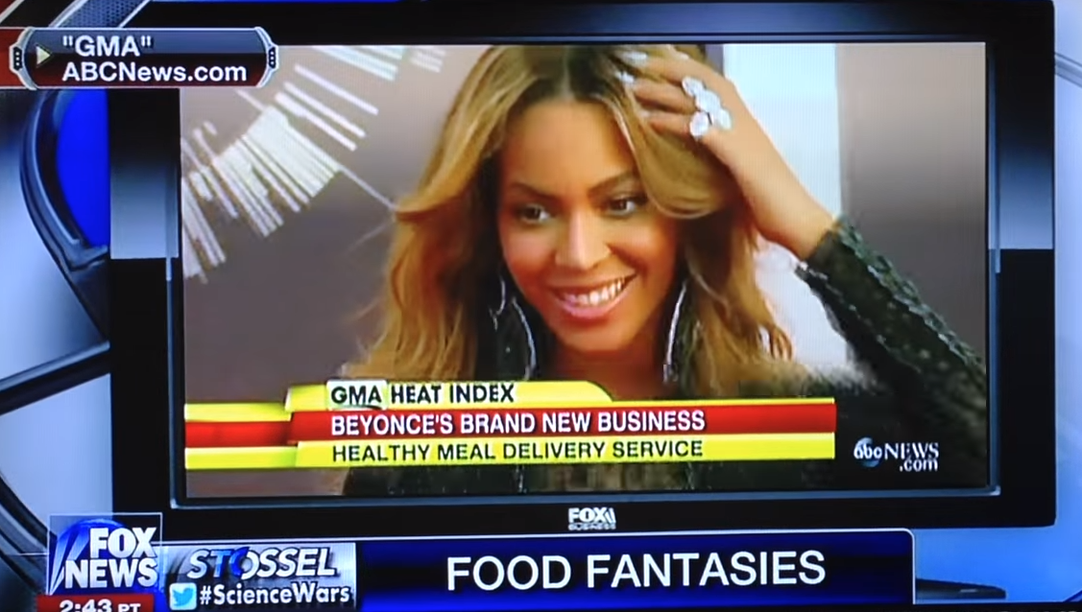

Slide 13
Why does it matter?
2018 Total Farm Receipts = $373 billion
  $175 billion of animal products (47%)
  $56.5 billion of feed grains (15%)
    43% of domestic corn use goes directly to animals
    Another 20% indirectly reaches animals via distillers grains
  $39.8 billion soybeans (11%)
    About 85% soybean meal goes to animals
Source: USDA ERS and USDA WASDE reports

Slide 14

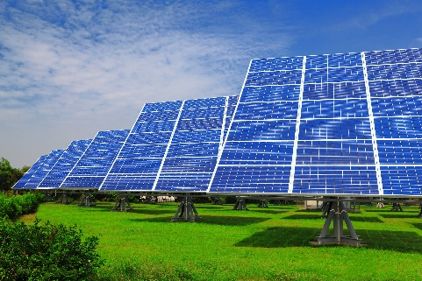




An Analogy

Slide 15
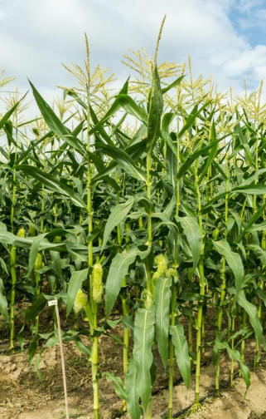
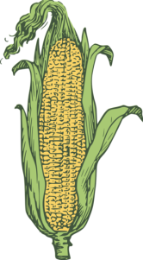
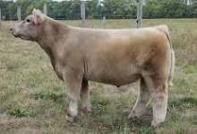

An Analogy

Slide 16
Consumer Demand
Source: Analysis of BLS, Consumer Expenditure Survey Data; in 2017 $’s per Household per Year

Slide 17
Source: Analysis of USDA-ERS data

Slide 18
Source: Analysis of USDA-ERS data

Slide 19
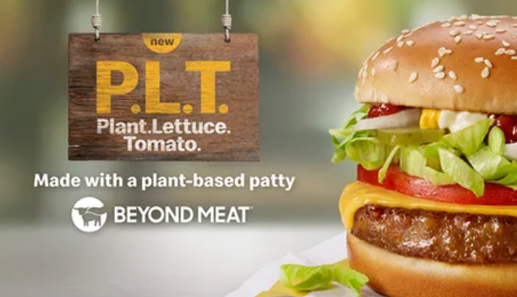

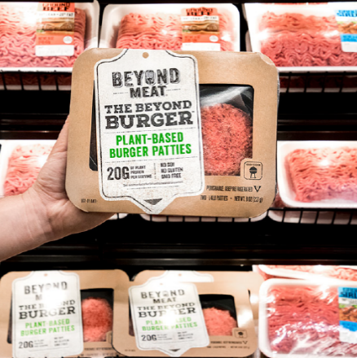
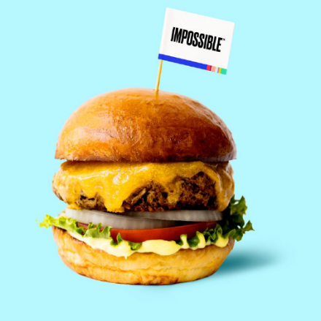
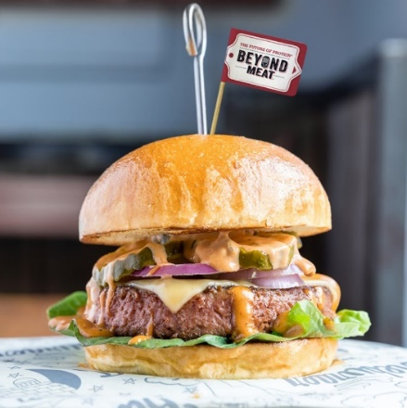
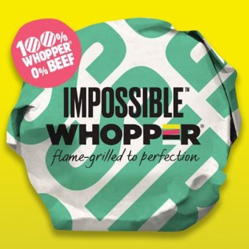
New Competitive Pressures

Slide 20
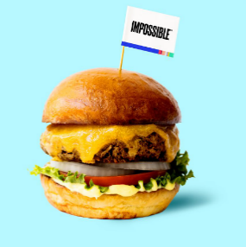

New generation of plant-based burgers
New plant-based burger patties that create a meat-eating experience designed to mimic the taste and texture of beef
Heme protein (leghemoglobin) produced by GM yeast, for meaty flavour and appearance (Impossible Burger).
Pea protein and beet juice resulting in a burger that ‘bleeds’ like a traditional beef burger (Beyond Burger).

Slide 21


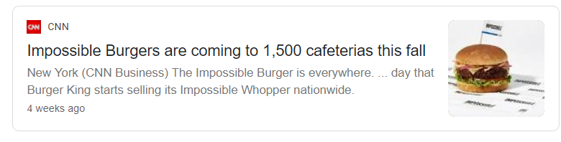
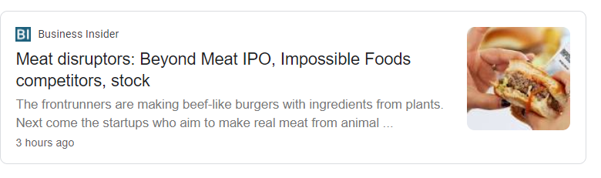
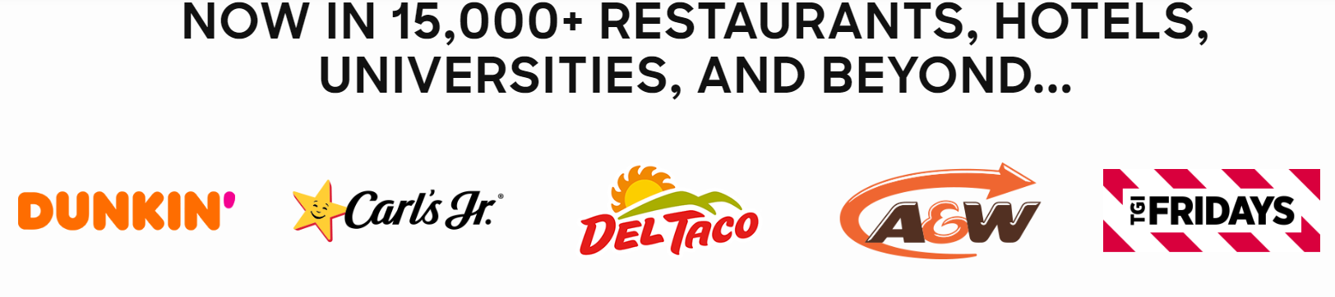
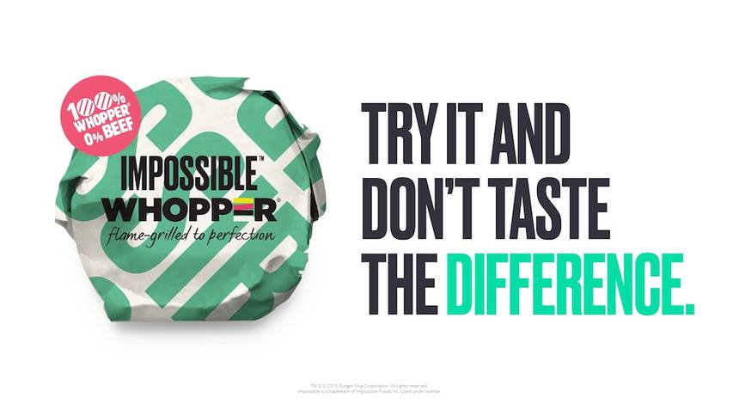
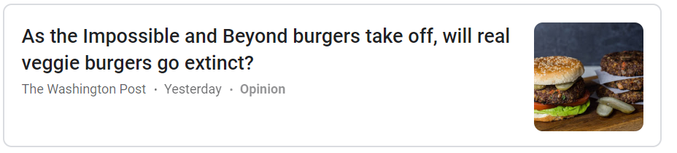
New generation of plant-based burgers
Notes:
Has any of you tried the impossible burger or the beyond meat burger?

Slide 22
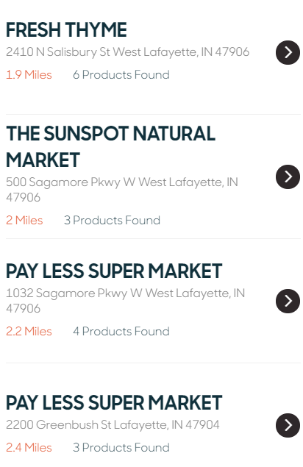
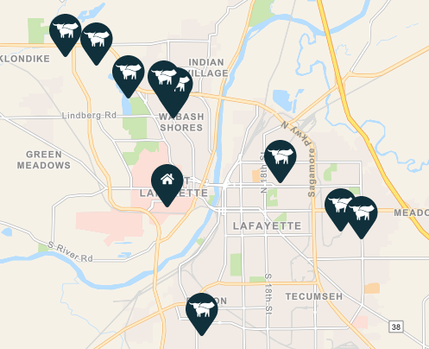
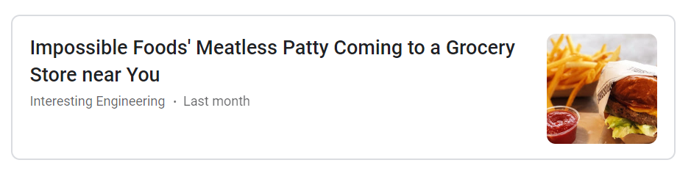
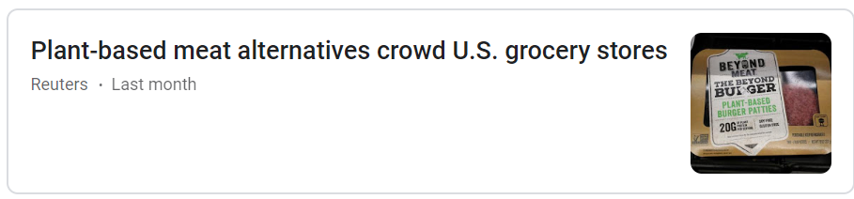
In grocery stores
Notes:
While Beyond Burger© is currently offered in grocery stores, until very recently the Impossible Burger© was only available in restaurants

Slide 23
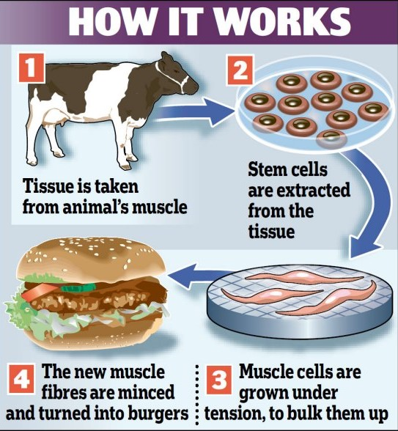



Labgrown meat
Several start-ups are currently developing a burger patty by culturing animal cells, a labgrown burger patty
not yet available to consumers
Notes:
Memphis Meats, a Silicon Valley clean meat startup funded by Bill Gates and Richard Branson, is experimenting with using Crispr to make its chicken and beef.

Slide 24
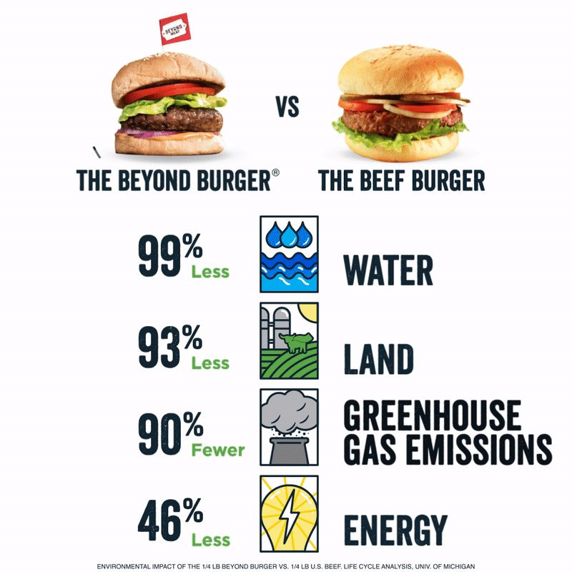
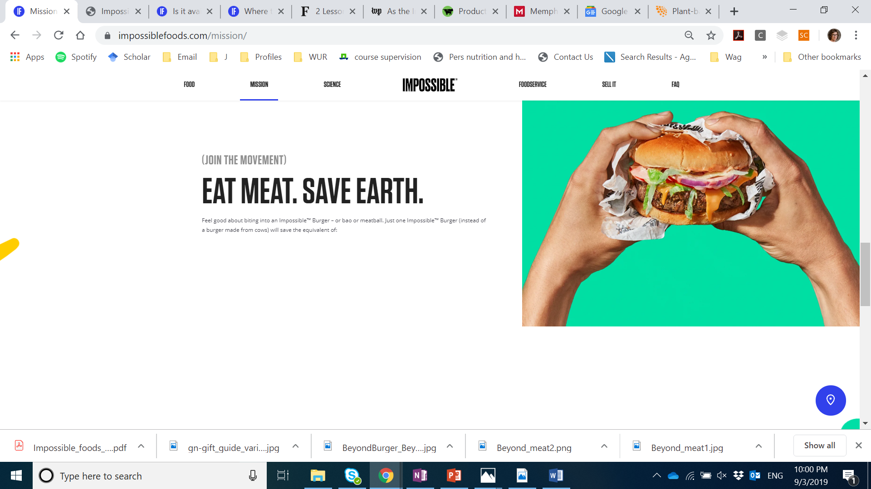
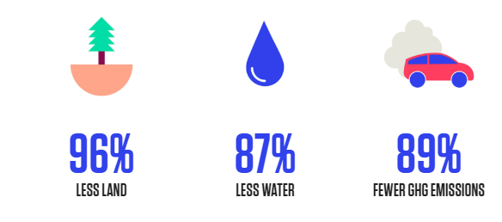
Environmental impact communicated to consumers

Slide 25
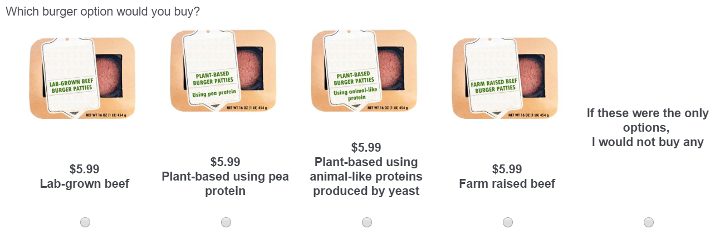
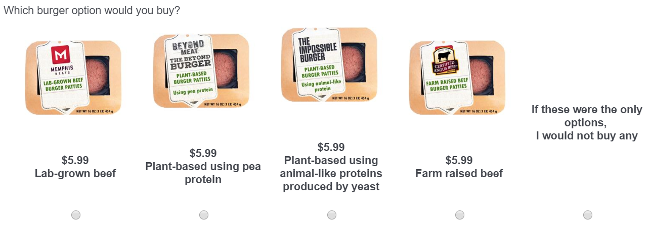
Control: No Brand Names
With Brand Names

Slide 26
Source: Van Loo, Caputo, and Lusk, Food Policy, 2020

Slide 27
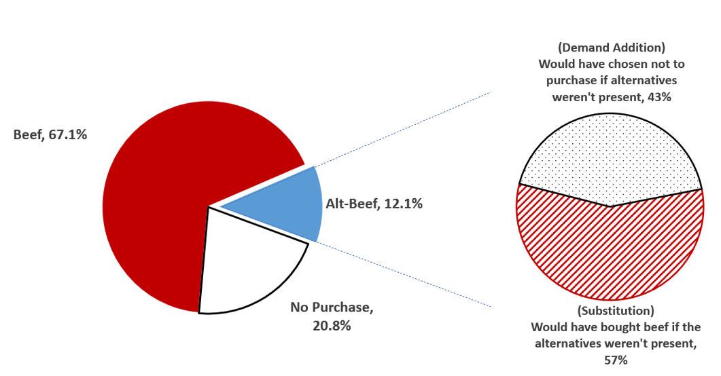
Demand Expansion or Substitution?

Slide 28
Who Wants Alt-Beef?
Characteristic | Beef Buyers (N=1360) | Alt-Beef Buyers (N=470) | Difference
% Vegetarian | 1.9% | 25.5% | -23.6%
% with Children under 12 | 25.8% | 36.8% | -11.0%
% with BS degree or higher | 33.4% | 40.0% | -6.6%
% Female | 47.1% | 46.2% | 0.9%
% with Household Income < $40,000 | 19.5% | 18.1% | 1.4%
% with Household Income between $40,000 and $80,000 | 33.5% | 31.9% | 1.5%
% with Household Income between 840,000 and $120,000 | 13.5% | 15.3% | -1.9%
% with Household Income > $120,000 | 8.2% | 12.3% | -4.1%
Average age in years) | 48.04 | 40.33 | 7.70
% younger than 30 years | 18.6% | 37.2% | -18.6%
# people in Household | 2.49 | 2.57 | -0.07
% residing in Northeast | 17.7% | 21.3% | -3.6%
% residing in Midwest | 22.9% | 17.4% | 5.4%
% residing in South | 38.6% | 38.1% | 0.5%
% residing in West | 20.8% | 23.2% | -2.4%

Slide 29
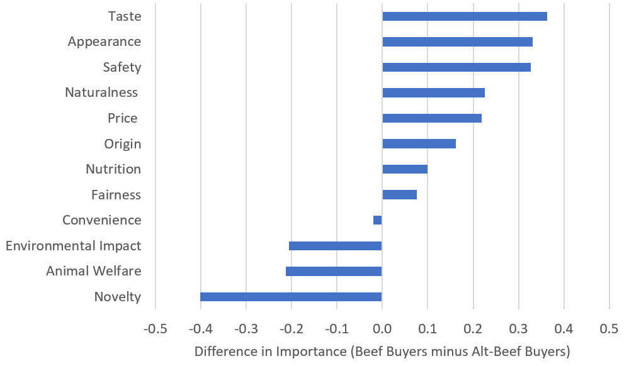
How important are the following items to you when purchasing food?
(1=very unimportant; 5 = very important)
More Important to Traditional Beef Buyers
More Important to Alt-Beef Buyers

Slide 30
Quality Perceptions
Source: Van Loo, Caputo, and Lusk, 2019, working paper

Slide 31
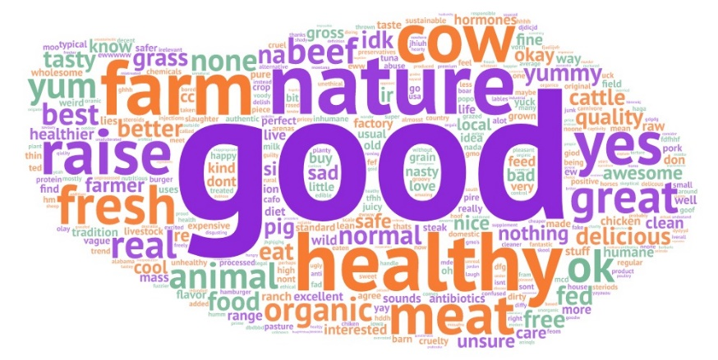
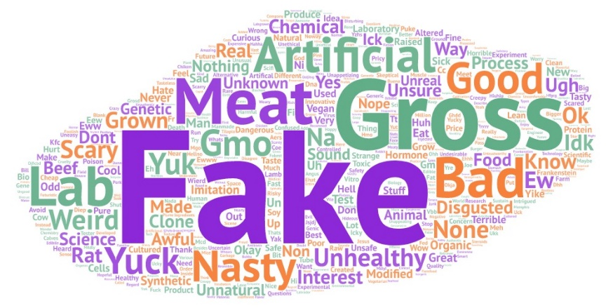
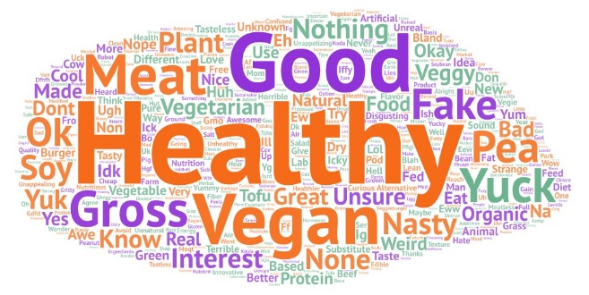
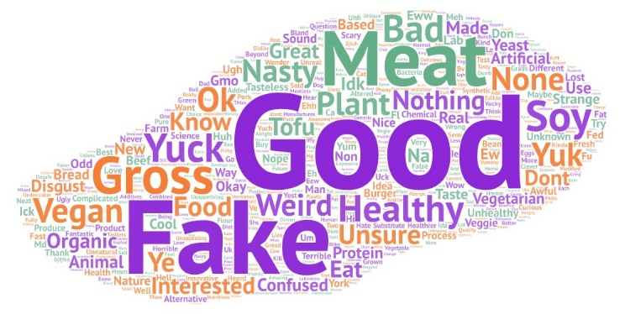
What do you think about when you hear the words...?
Farm-raised meat
Labgrown meat
Plant-based meat using pea protein
Plant-based meat using animal-like protein produced by yeast

Slide 32
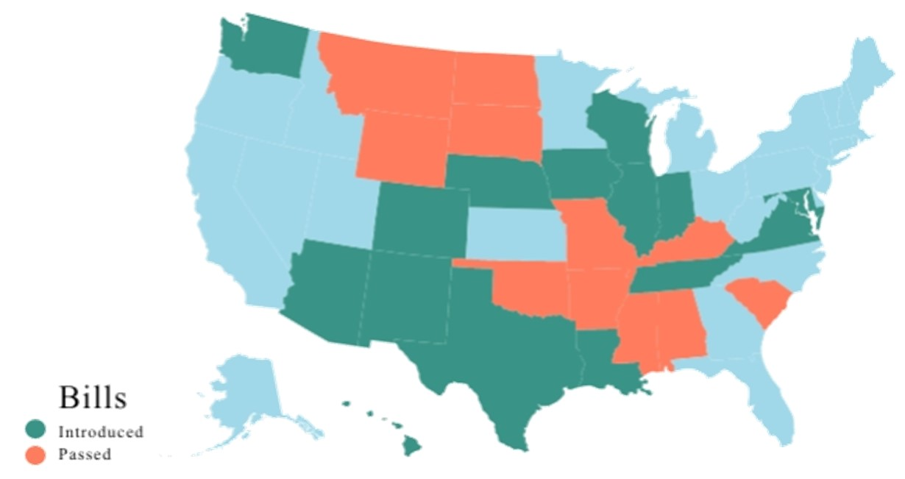
Meat Labeling Laws
Source: Trey Malone

Slide 33
Preferences for Meat Labeling Laws
 | it should be allowed to be labelled as “beef” | the USDA and FDA should prohibit the use of the word ‘beef’ on the labels for these products
lab-grown meat | 29.8% | 70.2%
plant-based meat using pea protein | 23.9% | 76.1%
plant-based meat using animal-like proteins produced by yeast | 24.2% | 75.8%
Source: Van Loo, Caputo, and Lusk, Food Policy, 2020

Slide 34
Preferences for Meat Labeling Laws
Policy | Support | Oppose
10% tax on beef from cattle in an effort to reduce beef consumption for environmental and animal welfare objectives | 36.2% | 63.8%
Require that any product labeled as “beef” come from cattle that have been born, raised, and harvested in the traditional manner, rather than coming from alternative sources such as a synthetic product from plant, insects, or other non-animal components and any product grown in labs from animal cells | 81.0% | 19.0%
Source: Van Loo, Caputo, and Lusk, Food Policy, 2020

Slide 35


Labeling Laws

Slide 36

Labeling Laws
Source: Trey Malone

Slide 37
How to Compete?

Slide 38

Increased Productivity
Fewer, more productive cows
Source: Lusk calculations based on USDA data

Slide 39

Increased Productivity
Total beef production in 2018 = 26.9 billion lbs
  cattle inventory in 2018 = 94 million head
Using 1970s technology, how many more cattle would be needed to achieve 2018 production?
  required cattle inventory = 140 million head
94 million head 46 million head
actual saved
33% ↓

Slide 40
Increased “Quality”
Perceptions of “naturalness”
Benefits to farms vs. “factories”
Taste
Variety of offerings
94 million head 46 million head
actual saved

Slide 41




Contact:
jayson.lusk@gmail.com
765-494-1903
www.jaysonlusk.com
@JaysonLusk

