Slide 1
Market Impacts of the African Swine Fever Outbreak in China
H. Holly Wang
Department of Agricultural Economics, Purdue University
Farm Policy Study Group
December 10, 2019, West Lafayette, IN

Slide 2
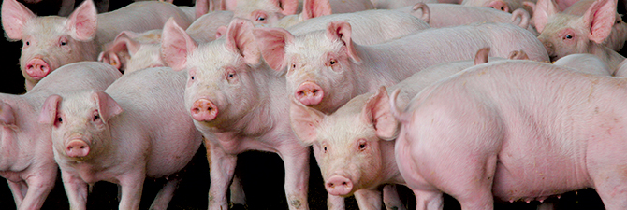
Outline
China and the world’s pork markets
ASF impact on China’s domestic market
Supply
Prices
Consumer demand
Market response to government’s actions
China’s import and impact on other countries
Threat on the US hog industry

Slide 3
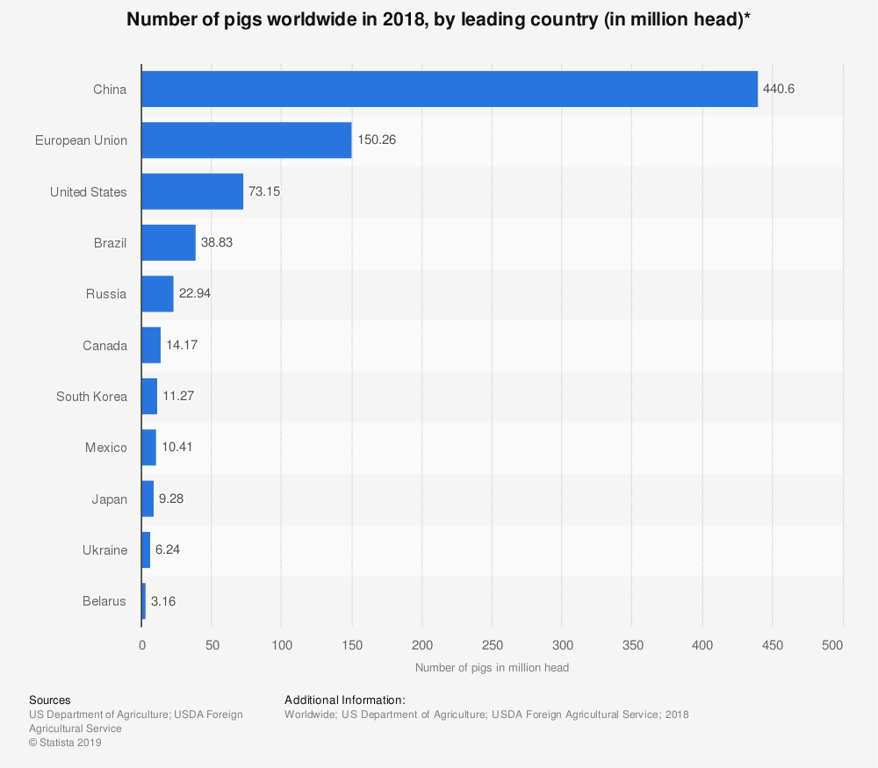
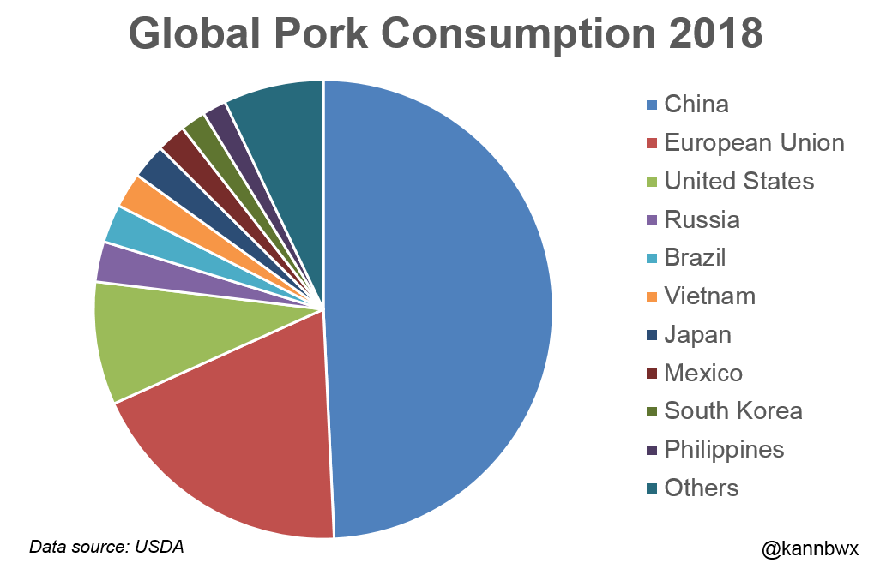
China and the World Pork Market
China is the world’s largest pork producer and consumer, accounting for ~50% (USDA FAS).
2018 inventory (production would double)
China: 440M
EU: 150M
US: 73M
Brazil: 39M
Russia: 23M

Slide 4
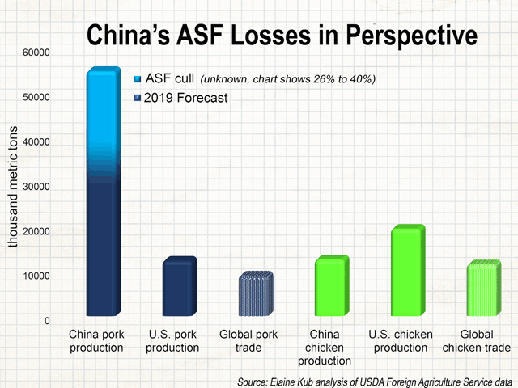
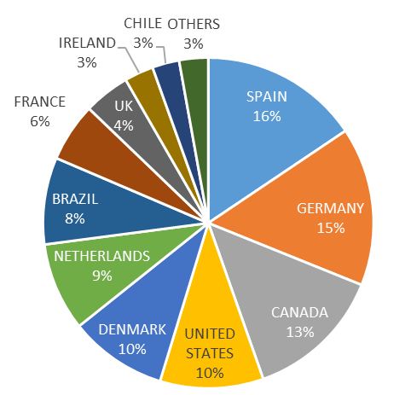
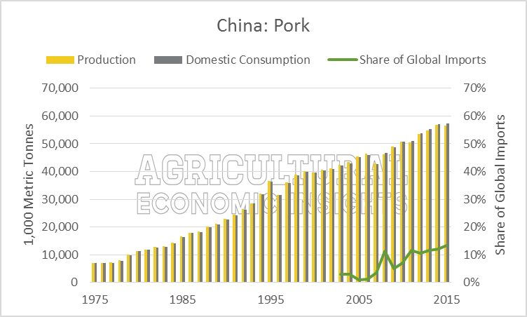
Chinese Pork Import
China is a net pork importer.
It imports <3% of its consumption, but accounts for >10% of the world trade
SP, GR,CA, US, DM, NE, BR, FR
The ASF loss is huge relative to global trade
Import sources
April-Nov, 2018

Slide 5
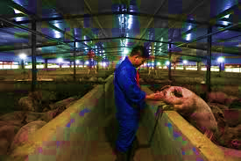
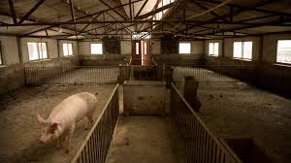
ASF Impact on China Domestic Supply
ASF eliminated ~ ½ of Chinese hog and breeding sow stocks
The trend got flat in the last month
Reasons for the fast spread:
Small scale hog farms, vulnerable biosecurity measurement
Farmers’ lack of trust to the government payment, selling infected herd
Local government wants to increase supply and reduce financial burden, covering up

Slide 6
ASF Impact on China Domestic Market
Pork price was more than doubled in 2019
Lowest in the spring of 2018, and peaked in October 2019
Dropped slightly in the last month
A sign of rebounce at the year end

Slide 7
Market Analysis
Supply driven market price response
Liquidation first, causing price to drop
Inventory drop started in late 2018, causing sharp price rise in the summer of 2019, a lag of seven months, roughly the hog growing cycle
Supply reacts to market price, secondary effect
Slaughter hog size dropped first, risk averse decision; then size increase later, profit driven decision
Late fall of 2019, super high price induces cautious restocking
Demand response
Pork has been staple meat in China
Inelastic, -0.5
Data 80-03
Data 80-19
Substitutive
Poultry, fish, beef
Demand reduced

Slide 8
Market Response to Government Actions
Supply side
Release pork reserve: little effect
Small quantity
Frozen pork, two separate prices
Subsidize investment and relax environmental regulations in production: slow response
Limited breeding stock to supply piglets
ASF not under control, high risk
Breeding sow stock rose slightly, hog stock decline slowed down
Demand side
Monitor and crack down speculative behaviors
Ration in some cities

Slide 9
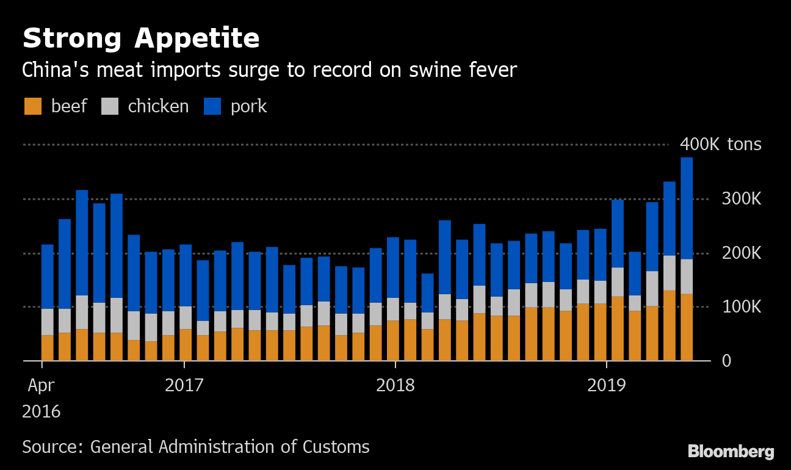
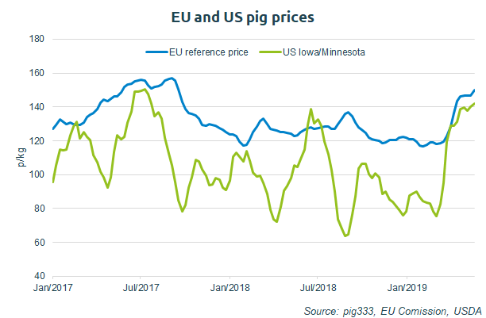
China’s Pork Import and Impact on Other Countries
China has increased it pork import
A global shortfall in meat supply, and rise in price
The primary importing source is EU, including newer countries like Italy.
Other sources are like AG
Surrounding countries also got infected, VN, MG, KR, PH, LA, and see price surge

Slide 10
What if ASF hit the U.S.?
As the world’s 2nd largest hog producing country, the impact of ASF outbreak is serious (Lusk analysis):
A 10% production reduction will bring a price increase 2%-7%, and $1B loss to U.S. producers and consumers each, giving all else the same
Producer loss will rise to $3.6B while consumer gain $1.2B, if our overseas market countries ban our exports because domestic price will drop by 2%-8%
If the ASF can reduce production by 50%, the producer and consumer losses will be $5B each, or $7 and $3 respectively, depending on export reactions
Biosecurity in the U.S.
Rely on modern technology with strict measurement
Government provides incentives to farmers to help curb the spread

Slide 11
THNAK YOU

