Slide 1
The Agricultural Alumni Seed Improvement Association, Inc. Farm Policy Study Group Gene Editing & the Seed Industry December 4, 2018
Your Future is our Foundation

Slide 2
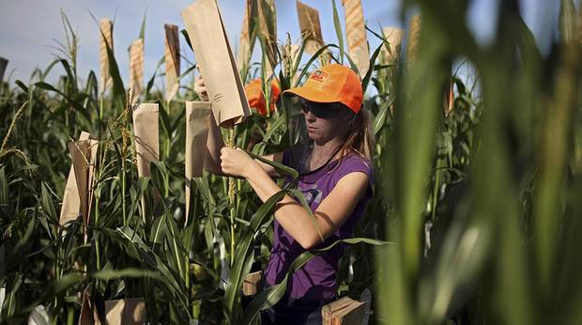
Gene Editing in Context
Traditional Plant Breeding
Notes:
Determination of Breeding Objectives
Collection of Germplasm
Evaluation of Segregating Population (“Natural” genetic diversity from recombination and mutation)
Chemical and/or Radiation Mutagenesis
Crossing/Backcrossing/Selfing
Visual evaluation in field
Greenhouse screens for disease R
Test crossing
Field Evaluation
Finishing Parent Lines for Production

Slide 3
“Traditional” Plant Breeding
100 Year old Technology
Relatively Cheap
Up to a 10 year process, Start to Finish

Slide 4
Enter Biotechnology
Promise of novel traits, faster breeding cycles
But expensive technology
And…

Slide 5
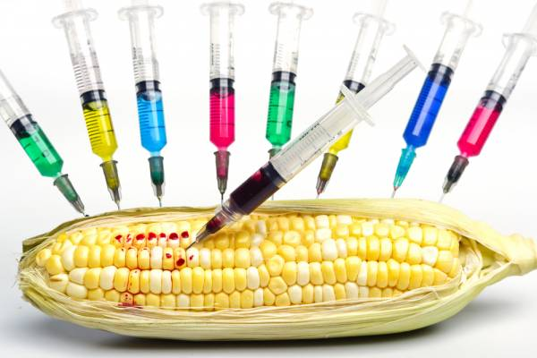
Enter Biotechnology
Instant Controversy
Technological Advance? Or Frankenfood Disaster?

Slide 6
Regulated Technology
Industry all about Science, NGOs about Emotion
EU and Many Other Countries Effective Ban
Controversy Never Went Away
Bifurcation of Technology
Regulated
Unregulated
Notes:
Industry all about Science, NGOs about Emotion
Controversy Never Went Away
Botched introduction by US Companies
Nimble work by Greenpeace et al
An unrecoverable error, for longer than a generation
EU and Many Other Countries
Outlawed or so highly regulated as to be outlawed
Hungary has “no GMO” in their constitution
Bifurcation of Technology
Regulated
Unregulated

Slide 7
Regulated Technology
Genetic Transformation
Insertion of DNA from a Foreign Organism
Notes:
Genetic Transformation
Insertion of DNA from a Foreign Organism
Almost immediately regulated everywhere
Regulation on pharmaceutical model
Early Work on Niche crops; “Flavr Savr” Tomato
Market too small to support regulatory cost
Difficult value capture mechanism (benefits accrue to food companies or consumers, not to farmers)
Required forward integration into the market

Slide 8
Regulated Technology
Focus on Major Commodities: Corn, Soybeans, Cotton, a Few Others
Work on Niche crops; “Flavr Savr” Tomato
Stalled Out
High Initial Cost, High Regulatory Cost
Long Time for Approvals, Slower Breeding Cycles
Result was Industry Hegemony by Bayer, Corteva
Notes:
Focus on Major Commodities: Corn, Soybeans, Cotton
Enough scale to provide for ROI
Compelling needs easily addressed: Weed & Insect
Easy value capture mechanism: Benefits accrue to Farmers, easy to capture value in the seed
High Initial Cost: Entirely new facet to plant breeding
High Regulatory Cost $120,000,000 per event
Long Time for Approvals, Slower Breeding Cycles
Result was Industry Hegemony by Bayer, Corteva

Slide 9
Regulated Technology
Popcorn Industry Case
BT & Roundup Ready work Done by Late ‘90s
Popcorn Companies Decided Against GMO Products
Notes:
Popcorn Industry Case
BT & Roundup Ready work initiated Late ‘90s
Supported by Monsanto
Ag Alumni Seed and others had hybrids ready to go
Popcorn Companies Decided Against GMO Products
Popcorn is a Globally Traded Commodity
GMO Popcorn abandoned in 1999 in the face of resistance outside of the US
Abandonment reinforced by growing US resistance

Slide 10
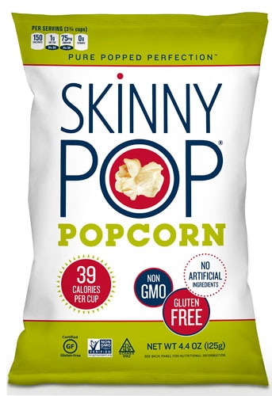
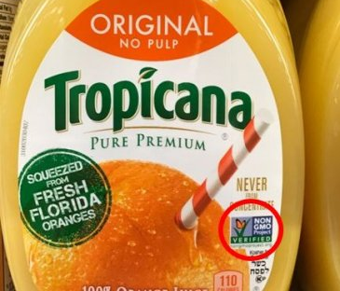
Marketing Non-GMO

Slide 11
Unregulated Technology
“Sleeper” Technology of the Biotech Revolution
Genetic Markers and Sequencing
Dihaploid Technology
Notes:
“Sleeper” Technology of the Biotech Revolution
Genetic Markers and Sequencing
Now commonly used
Augment traditional breeding
Allow breeders to induce mutations with EMS or radiation, then rapidly select for useful mutations
Reduce numbers of plants a breeder has to evaluate
Dihaploid Technology
“Instant inbreds” to speed the breeding cycle
Optimized when used with markers
Ethyl methanesulfonate

Slide 12
Unregulated Technology
Unregulated Biotechnology has Become Fast, Cheap and Ubiquitous
Regulated Technology in a Handful of Major Commodity Crops Only

Slide 13
Enter Gene Editing
“Knock-out” of a Gene
“Knock-in” of a Gene from the Same Species
Writing new DNA into a Plant’s Genome
Notes:
Knock-out” of a gene
Deletion of a target gene
Clear case for unregulated use
Targeted, relatively inexpensive, nothing that traditional breeding can’t do
“Knock-in” of a gene from the Same Species
Example of disease resistance from tropical corn into Midwest lines
Faster, no “linkage drag”
Writing new DNA into a plant genome
Copying a gene from an unrelated organism
Creation of a completely novel gene

Slide 14
Gene Editing
Potentially faster AND cheaper extension of conventional breeding technology
Promise of True “Disruptive” Technology
Notes:
Potentially faster AND cheaper extension of conventional breeding technology
Convergence of current unregulated technology with gene editing allows for much shorter breeding cycles
Promise of True “Disruptive” Technology
Avoiding onerous regulatory cost opens it up to current niche seed businesses
Creates opportunities for startups in the seed industry

Slide 15
To Regulate, or Not to Regulate?
Clear case for “Knock-out” to be Unregulated
Good case for “Knock-in” to be Unregulated
Reasonable case for writing new DNA to be Regulated
Notes:
Clear case for “Knock-out” to be unregulated
Achievable from conventional breeding or mutagenesis
Good case for “Knock-in” to be unregulated
Achievable via conventional breeding
Reasonable case for writing new DNA to be regulated
Risk: Dangerous mutations resulting in toxins or Allergens, “Frankenfoods”

Slide 16
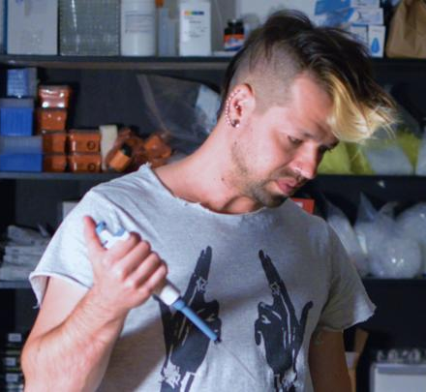
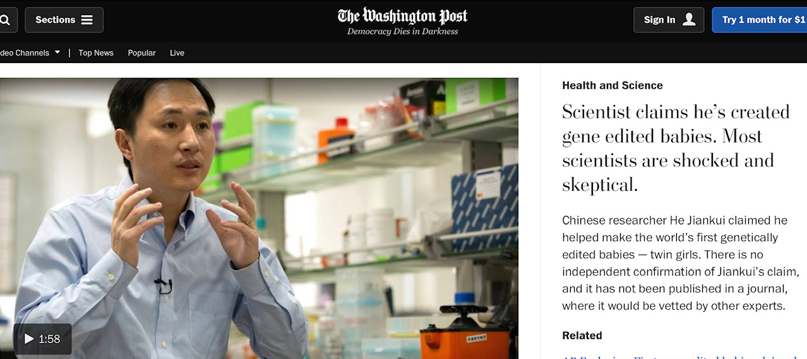
Potential Misuse of Gene Editing
Self-”Bio Hacking”
Gene Editing Babies for HIV Resistance

Slide 17
Potential Misuse of Gene Editing
Glow in the Dark Popcorn?

Slide 18
Opportunities
Ability to Adapt to Climate Change
Faster, Lower Cost Breeding of Major Crops
Notes:
Ability to Adapt to Climate Change
Attack rising temperature challenges
Enhance fertilizer use
Enhance drought tolerance
Enhance salinity tolerance
Faster, lower cost breeding of major crops
Corteva (Pioneer) will be first out with a waxy corn hybrid using “knock-out” CRISPR technology
Possible path to new herbicide resistance traits
Path to quality traits in major crops

Slide 19
Opportunities
Agronomic Traits in Major and Specialty Crops without Regulation
Consumer Traits in Specialty Crops without Regulation
Multiple Startups offering Gene Editing Technology
Notes:
Agronomic Traits in Specialty Crops without regulation
Herbicide resistance
Consumer Traits in Specialty Crops without regulation
Potential of enhanced flavor and nutrition without Compromising Shelf Life or Yield
Value capture still an unresolved issue
Multiple Startups offering Gene Editing Technology
Benson Hill
Inari Agriculture
Working on “Partnership” and Fee for Service Basis

Slide 20
Challenges
(De)regulation in the US
Regulation of all Gene Editing in the EU
China?
Notes:
(De)regulation in the US
USDA’s regulatory position is favorable to “Knock-out” and perhaps “Knock-in” technology
FDA and EPA have not yet weighed in
Regulation of all gene editing in the EU
Ruling by the EU High Court
Default position is “regulated”
Effectively bans use of Crispr for any globally traded specialty crops
Increases likelihood of regulation in other countries

Slide 21
More Challenges
Intellectual Property still being Litigated
Startups will Inevitably Sort Out in the Market
Specialty Companies; Move Fast, or Wait and See?
Notes:
Intellectual Property still being Litigated
(But research licenses available)
Startups will Inevitably Sort Out in the Market
Risk for a seed company of premature alliance with a “loser” and waste resources
Risk for a seed company to wait too long and be locked out
Specialty Companies:Move Fast, or Wait and See?
Desire to capture first mover advantage
Desire to avoid investing in what becomes a regulated technology with prohibitive costs
Broad Institute & Harvard versus UC Berkeley & University of Vienna

Slide 22
Industry Communication
Message: “Natural” Extension of Traditional Breeding
Industry Still Reluctant to “Emote”
Potential for Completely Novel Applications
Notes:
Message: “Natural” Extension of Traditional Breeding
Seed Industry avoiding “gene editing” terminology
Referring to “Plant Breeding Innovation” or “New Breeding Methods”
Focused on working with Regulators, Limited Engagement with Public at Large
Industry Still Reluctant to “Emote”
Uncomfortable with non-scientific arguments
First reaction always to explain the science
Potential for Completely Novel Applications
Industry Uncomfortable Talking About This
Avoiding all discussion

Slide 23
Seed Industry
We are living in Interesting Times!
Big Guys Already Moving
Niche Players “Waiting and Seeing”
Value Capture of Consumer Traits?
Everyone Hesitant to Talk too Much
Potentially Disruptive Players in the Wings

Slide 24
Gene Editing & the Seed Industry
Questions?

