Slide 1
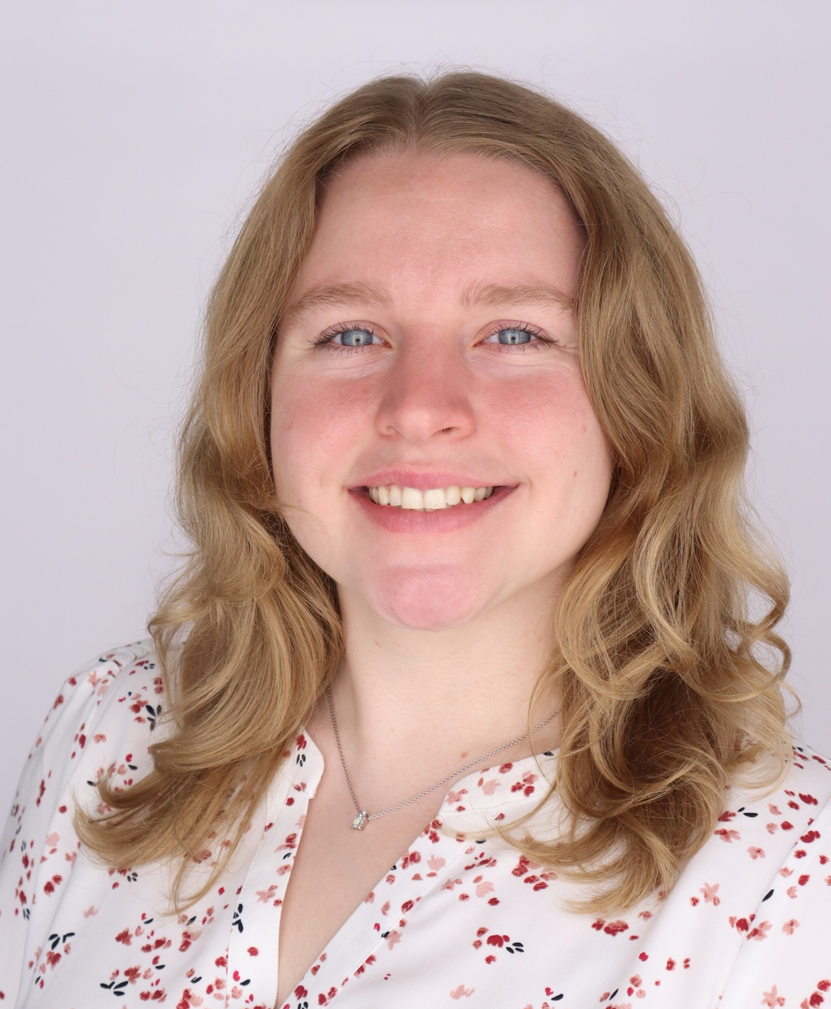
The Department of Animal Sciences
presents
Melanie Bergman
Monday, July 8, 2024
10:00 a.m. CRTN 1042
Or Join Zoom Meeting
https://purdue-edu.zoom.us/j/94821751618
Meeting ID: 948 2175 1618
“Neuroendocrine Profiles of Pekin Ducks Associated with Positive and Negative Affective States.”
Final Defense Seminar
Major Advisor: Dr. Greg Fraley
Partial Fulfillment of the Master of Science Degree

